Slide 1
Germline and Somatic Mutation Analysis: Experimental Design, Variant Calling, and Analysis
Justin Lack
NIAID Collaborative Bioinformatics Resource (NCBR)
Frederick National Laboratory for Cancer Research
Jan. 23, 2019

Slide 2
Germline vs Somatic Variation
Germline Variant Analysis
  Heritable genetic variation
  Large cohort analysis -> GWAS/Burden testing (quantitative)
  Small cohort analysis -> Candidate gene identification (qualitative)
  Pedigree analysis -> variant/disease co-segregation
Somatic Variant Analysis
  Non-heritable genetic variation arising in non-germ cells
  Tumor/Normal or tumor-only analysis
  Somatic mosaicism (e.g., Neurofibromatosis)
Very different expectations in terms of allele frequency distribution

Slide 3
Germline vs Somatic Variant Calling
Potentially very different allele frequency expectations
Germline - ~0.5 read proportions
Somatic - ~0.3 read proportions

Slide 4
Germline vs Somatic Variant Calling
Potentially very different allele frequency expectations

Slide 5
Germline vs Somatic Variant Calling
Within-sample germline allele frequency variance is driven by sample quality and sequencing quality
  Amount of sample input
  Sequencing depth
  Read/base quality
Somatic allele frequency variance is driven by MANY more factors:
  Sample quality and sequencing quality
  Subclonality/heterogeneity
  Copy number variation
  Tumor purity

Slide 6
Depth Effects - Germline
~30X target for genome data (below)
~50X target for exome, due to increased depth variance
Telenti et al., 2016 PNAS
Notes:
On the left plot, blue dots show the proportion of the genome >=10X

Slide 7
Depth Effects - Germline
~30X target for genome data (below)
~50X target for exome, due to increased depth variance
Belkadi et al., 2015 PNAS

Slide 8
Depth Effects - Somatic
“Spike-in” simulation analysis of impact of tumor purity and sequencing depth
Simulated somatic variants into real germline whole exome sequencing on the NA12878 sample

Slide 9
Depth Effects - Somatic
Conservative recommendations:
  >50X target for germline exome
  >100X target for somatic exome
  Tumor purity ≥50% (ideally ≥60% for copy number calling)

Slide 10
Exome vs Whole Genome Sequencing

Slide 11
Exome vs Whole Genome Sequencing
Exome Sequencing
  Covers ~5% of genome (depending on capture kit)
  Allows for high depth targeting
  Most reasonable option for somatic variant analysis
  Poor copy number/structural variant calling
Genome Sequencing
  Confidently call >85% of reference genome (hg38)
  Confidently call copy number/structural variant calling due to reduced depth variance
  Significantly more accurate variant (SNP/INDEL) calling relative to exome
  Price for WGS comparable to exome for germline-only projects

Slide 12
Exome vs Whole Genome Sequencing
Depth variance MUCH higher for exome
~2-fold more variants with GQ < 20 for exome
Read ratio for heterozygous variants significantly skewed for exome
  Especially pronounced for INDELs
Belkadi et al., 2015 PNAS

Slide 13
Exome Capture Considerations
Significant capture and enrichment biases for different kits
Illustrates issue with combining samples from multiple kits
For germline-only analysis, WGS strongly preferred
Meienberg et al., 2015 Nucleic Acids Research

Slide 14
Exome vs Whole Genome Sequencing
Sure, there’s bias in WES introduced due to capture, but does it significantly affect variant calling?
Genome in a bottle (GIAB) truth sample (NA12878)
  50X WES and 30 WGS available from exact same sample
  Processed both WES and WGS through identical pipelines
  Compared both variant sets to GIAB truth set
  Used only exonic sites targeted in WES capture for performance assessment

Slide 15
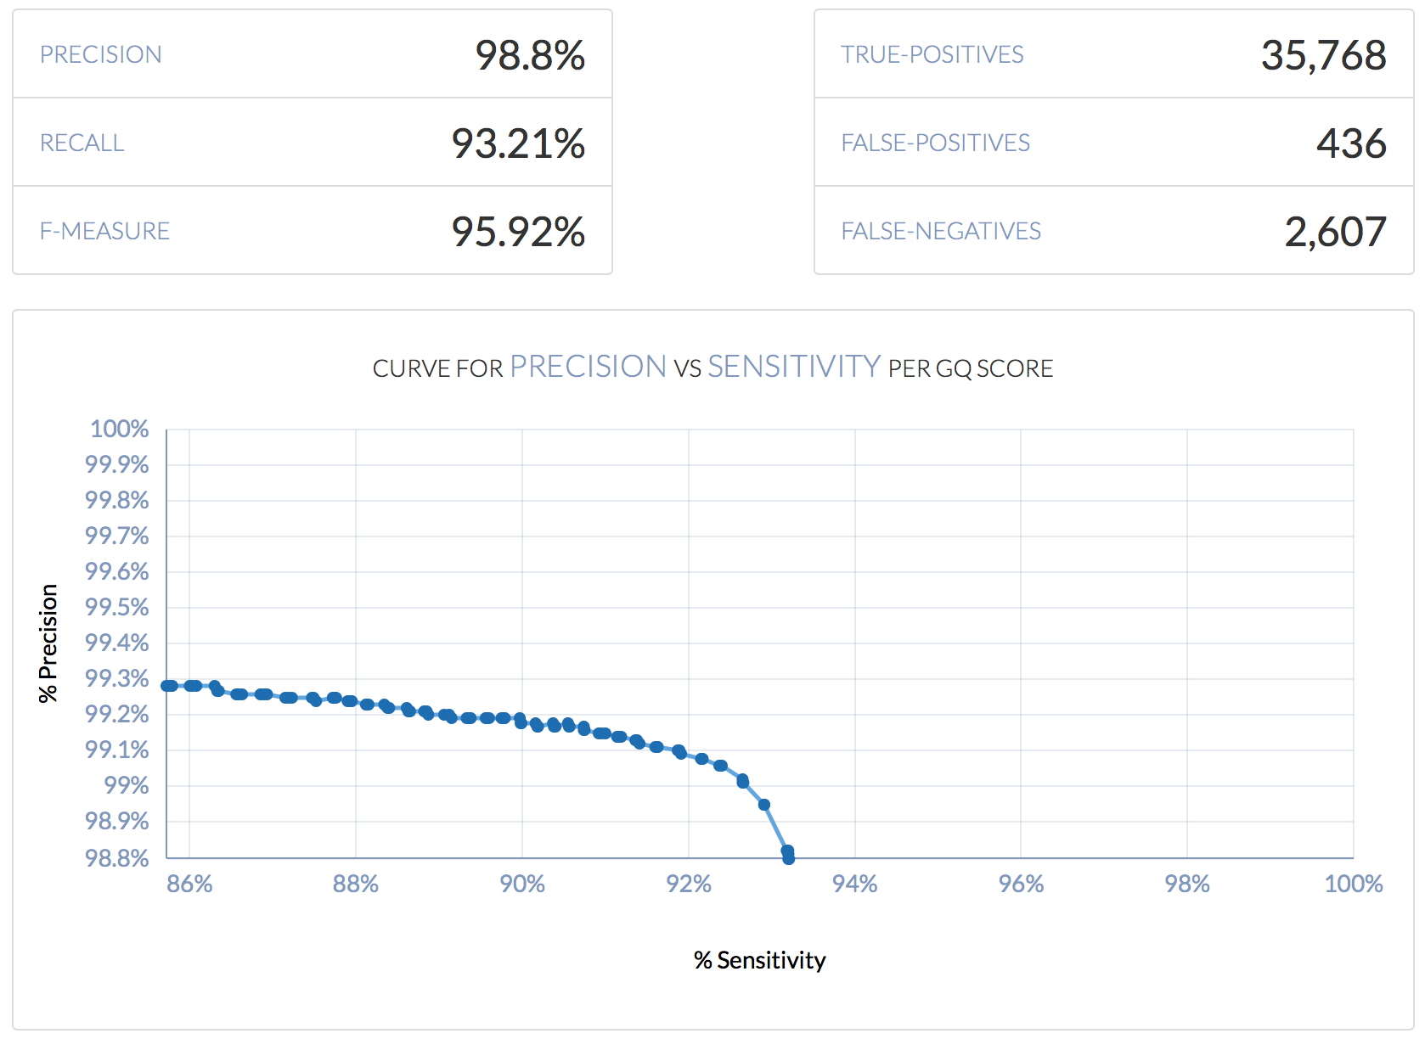
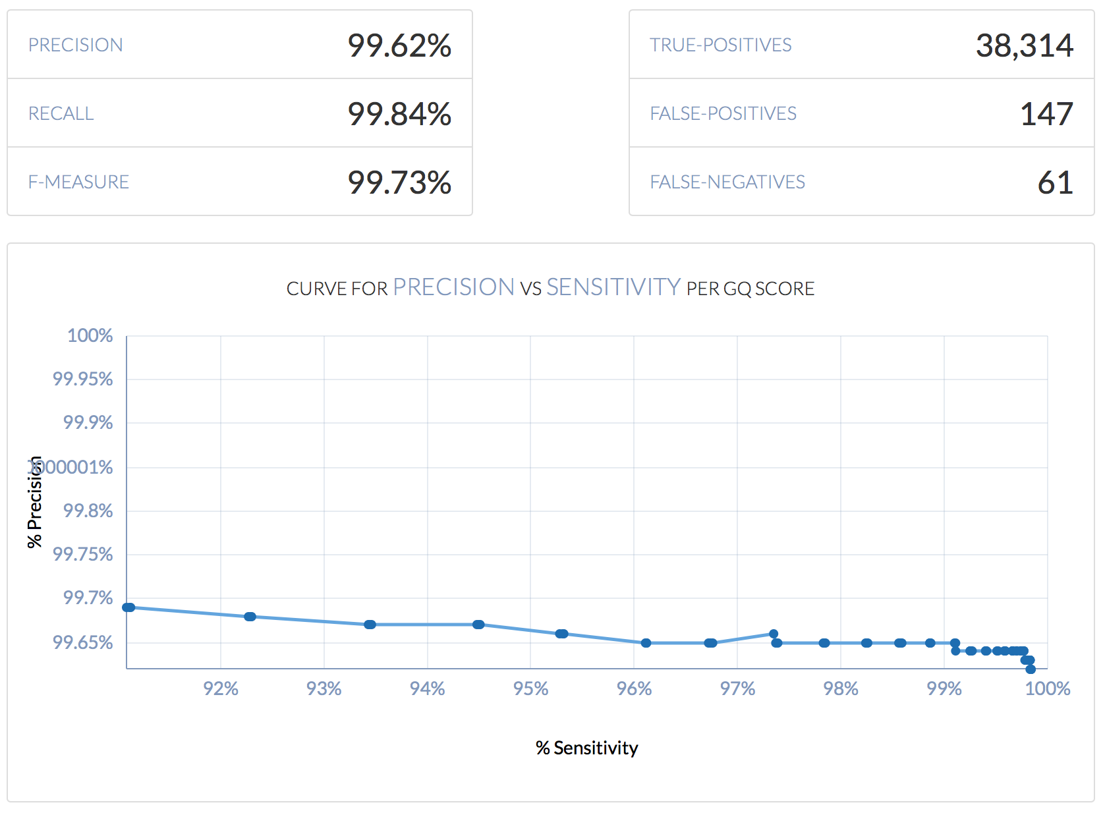
Exome vs Whole Genome Sequencing
Exome (50X WES)
Genome (30X WGS)

Slide 16
Exome vs Whole Genome Sequencing
  3X higher False Positive rate, and >40X higher False Negative rate for exome!!!
 | False Negative Rate | False Positive Rate
50X Whole Exome | 0.067934853 | 0.011361564
30X Genome (Exome Sites) | 0.001589577 | 0.003830619
Exome (50X WES)
Genome (30X WGS)

Slide 17
Somatic Variant Calling – Considerations and Best Practices

Slide 18
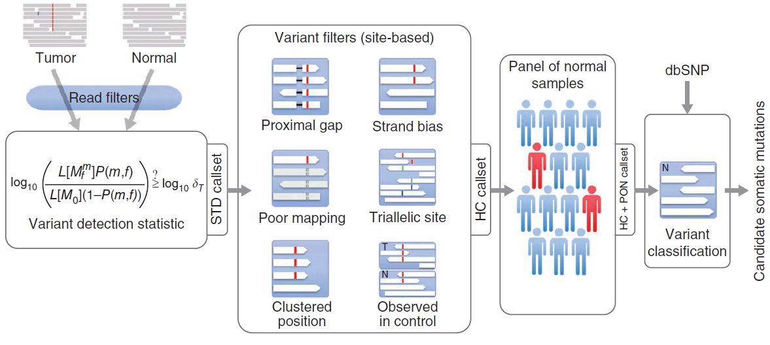
Paired Tumor/Normal vs Tumor-only Somatic Variant Calling

Slide 19
Paired Tumor/Normal vs Tumor-only Somatic Variant Calling
For tumor/normal calling, strong prior on variant evidence in germline sample

Slide 20
Paired Tumor/Normal vs Tumor-only Somatic Variant Calling
For tumor-only calling, germline contamination removed via a panel of normal (PON)
X

Slide 21
Panel of Normals (PON)
Collection of individuals assumed to be “normal”
Used to augment population frequency databases (e.g., ExAC, GnomAD)
  Population databases are highly filtered and curated
  Many segregating germline variants are missing from population databases because they occur in challenging portions of the genome to call genotypes
Also useful for removing systematic sequencing and mapping artifacts…

Slide 22
Panel of Normals (PON)
This is a tumor/normal cohort of adrenocortical carcinoma (ACC)
Most common driver gene for ACC is known to be beta-catenin (CTNNB1)
Somatic variant analysis for our cohort suggests RFPL4AL1 is the most frequently mutated gene
WE’RE GONNA BE FAMOUS! PUBLISH IN NEJM! WOOHOO!

Slide 23
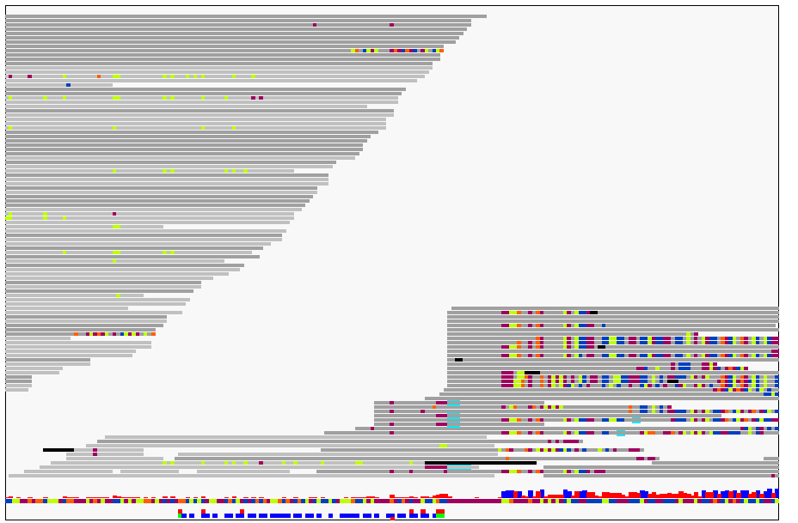
Panel of Normals (PON)
This is a tumor/normal cohort of adrenocortical carcinoma (ACC)
Most common driver gene for ACC is CTNNB1
Somatic variant analysis for our cohort suggests RFPL4AL1 is the most frequently mutated gene

Slide 24
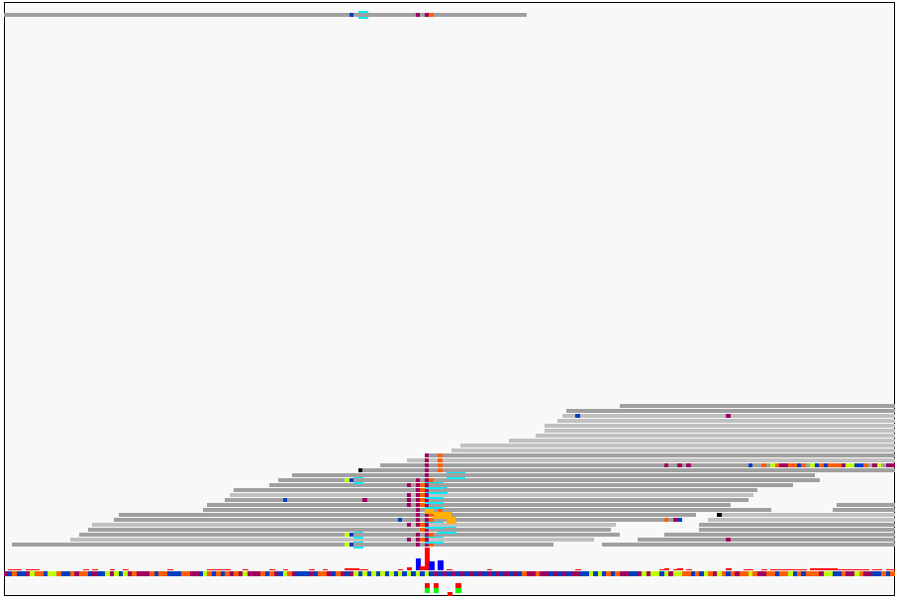
Panel of Normals (PON)

Slide 25
Panel of Normals (PON)
Collection of individuals assumed to be “normal”
Used to augment population frequency databases (e.g., GnomAD)
  Population databases are highly filtered and curated
  Many segregating germline variants are missing from population databases because they occur in challenging portions of the genome to call genotypes
Even with matched germline, these artifacts will be prevalent, and because they are systematic, they can be widespread
PON that was processed in (approximately) the same way as the case samples can remove many of these artifacts

Slide 26
PON Development at CCBR/NCBR
211 unaffected spouses from diversity of NCBR/CCBR germline projects
445 additional germlines from “normals” in various publicly available databases
All WES samples
  Processed with variety of WES capture kits (Agilent, Illumina, etc.)
  Sequenced on multiple Illumina platforms
Processed each sample individually in PON mode in MuTect2
Retained only variants present in >=2 samples

Slide 27
PON Development
Annotated the entire raw PON with gene information using VEP
Removed any variant in the gene region of a gene in the COSMIC v84 database
Removed any variant in a confirmed gene from ClinVar that was annotated as Pathogenic, Potentially Pathogenic, Drug Response, and Risk Factor
Removed any specific variant identified in ClinVar as “Associated”
Pooled all remaining variants into a single PON

Slide 28
PON Performance
No PON
With PON
X
X
X
X

Slide 29
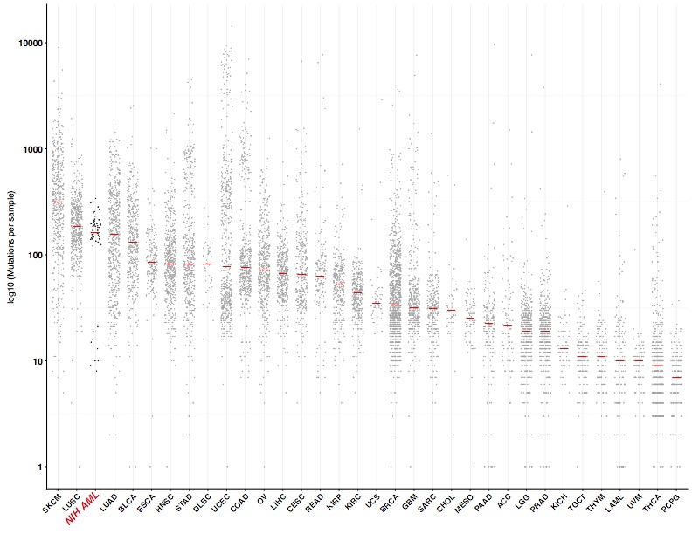
Paired Tumor/Normal vs Tumor-only Somatic Variant Calling
Even with a PON, false positive rate will be significantly higher for tumor-only relative to tumor/normal calling

Slide 30
Paired Tumor/Normal vs Tumor-only Somatic Variant Calling
TCGA AML
Even with a PON, false positive rate will be significantly higher for tumor-only relative to tumor/normal calling
Tumor-only
Tumor/Normal

Slide 31
Tumor Heterogeneity/Subclonality

Slide 32
Tumor Heterogeneity/Subclonality
For identification of subclones, certain conditions required:
  High tumor purity****
  High depth/coverage (sky’s the limit!)
  Paired tumor-normal
  WGS has significantly higher sensitivity and accuracy
  WES alone performs poorly for copy number segmentation, inflates VAF variability, often too few mutational events per subclone

Slide 33
Tumor Heterogeneity/Subclonality
For identification of subclones, certain conditions required:
  High tumor purity****
  High depth/coverage (sky’s the limit!)
  Paired tumor-normal
  WGS has significantly higher sensitivity and accuracy
  WES alone can perform poorly for copy number segmentation, inflate VAF variability, and generate too few mutational events per subclone
150X WES
80X WGS

Slide 34
Tumor Heterogeneity/Subclonality
With paired tumor/normal and at least 150X WES we can accurately detect subclones as low as 10%

Slide 35
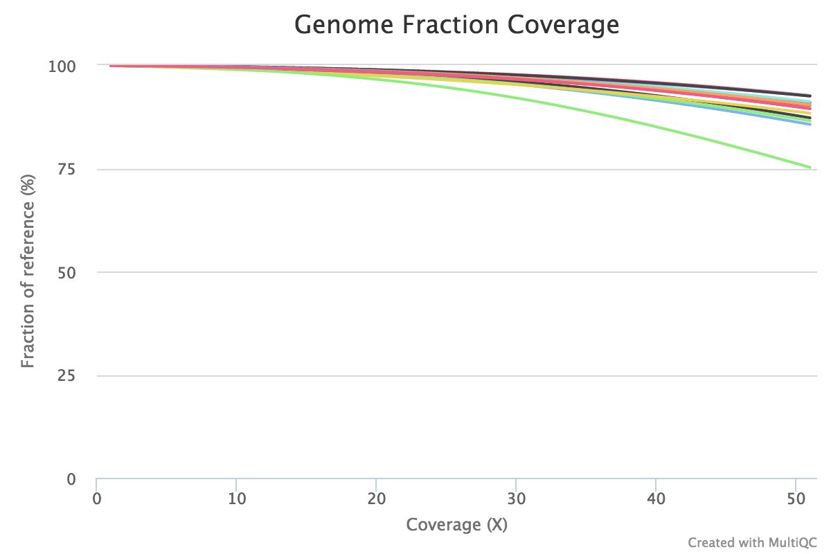
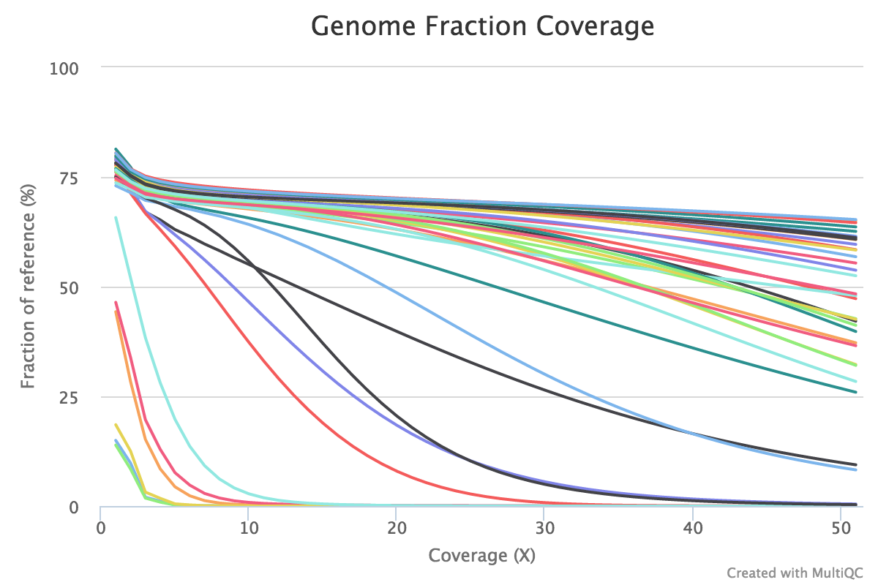
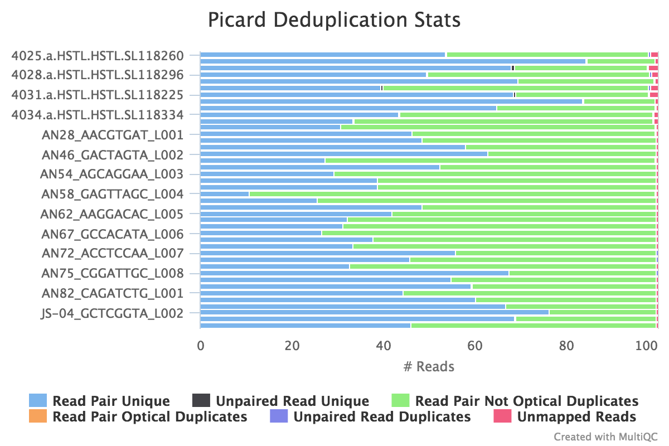
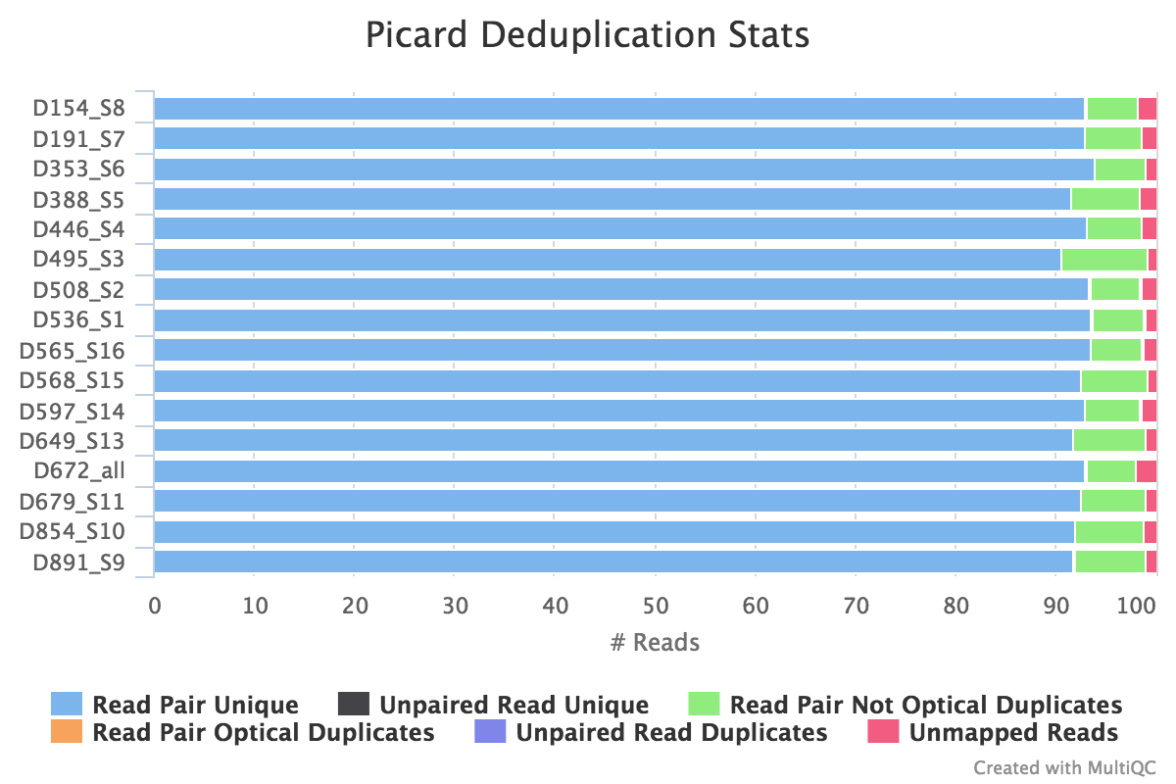
FFPE vs Fresh/Frozen Tissue – 50X target depth
Fresh/Frozen
FFPE

Slide 36
Somatic Variant Calling – Best Practices
STRONGLY favor paired tumor/normal design
For non-human samples (e.g., mouse models) without paired somatic/germline
  >=2 control/”germline” samples
>=100X/50X mean depth for tumor/normal samples
Significantly higher target depth for FFPE samples
Tumor purity >50% (ideally, >60%) for variant calling
MUST visually verify any somatic variant of “significance”
Subclone analysis requires WGS, high purity, and high depth

Slide 37
Germline Variant Calling – Considerations and Best Practices

Slide 38
GWAS/Burden Testing Design
“With an odds ratio (OR) = 1.4, the sample sizes required to achieve 80% power are 6,400, 54,000, and 540,000 for a MAF = 0.1, 0.01, and 0.001, respectively, if one assumes 5% disease prevalence and a significance level of 5 x 10⁻⁸. Because the number of rare variants is much larger than the number of common variants, more stringent significance levels might be required, further reducing power.”
Lee et al., 2014, American Journal of Human Genetics

Slide 39
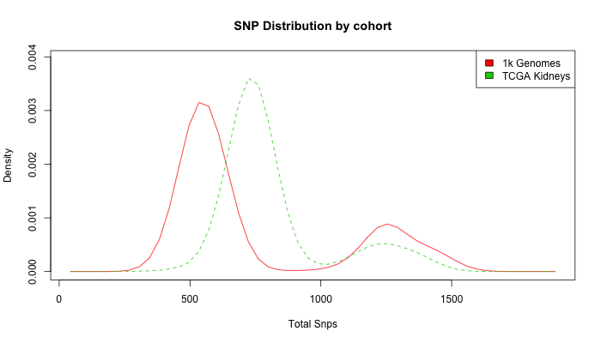
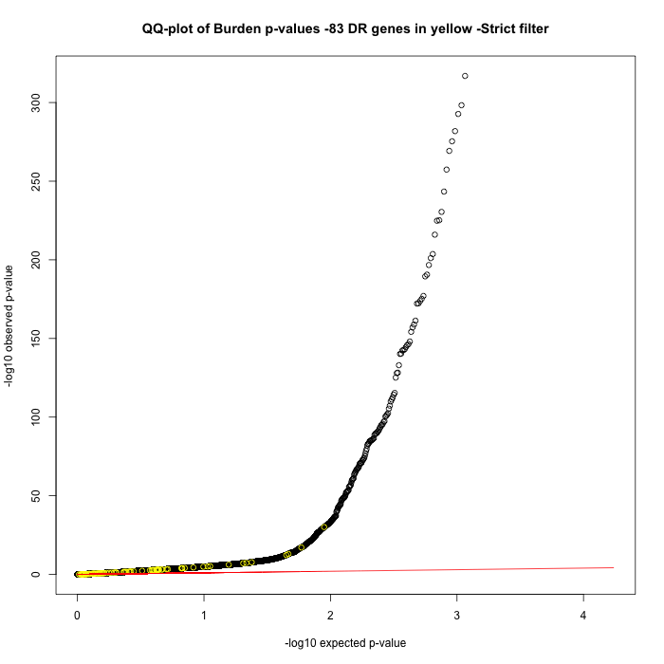
GWAS/Burden Testing Design
Biggest challenge is having data that is homogenous
Cases and controls MUST have genotype data that is generated identically

Slide 40
Familial Sequencing Design
Power is the primary limiting factor
When budgets are limited, decisions have to be made about who to sequence
F9
F10*
F1*
F11*
F12*
F13
F14
F49
F3
F4
F2*
F2-2
F16*
F15
S25
F183*
F184
F185
F187
F190
F191
F5*
F6*
F7*
F8
F186
F197*
F201

Slide 41
Familial Sequencing Design
3 cases, no controls
  3,176 candidates
3 cases, 1 spousal control (ethnicity matched) - 1542 candidates
  +1 spouse controls - 1121 candidates
  +1 case - 525 candidates
3 cases, 1 related control - 854 candidates
  +1 related control - 307 candidates
  +1 case – 284 candidates
F9
F10*
F1*
F11*
F12*
F13
F14
F49
F3
F4
F2*
F2-2
F16*
F15
S25
F183*
F184
F185
F187
F190
F191
F5*
F6*
F7*
F8
F186
F197*
F201

Slide 42
Familial Sequencing Design
3 cases, no controls
  3,176 candidates
3 cases, 1 spousal control (ethnicity matched) - 1542 candidates
  +1 spouse controls - 1121 candidates
  +1 case - 525 candidates
3 cases, 1 related control - 854 candidates
  +1 related control - 307 candidates
  +1 case – 284 candidates
F9
F10*
F1*
F11*
F12*
F13
F14
F49
F3
F4
F2*
F2-2
F16*
F15
S25
F183*
F184
F185
F187
ALWAYS PERFORM ETHNICITY-AWARE FILTERING!!!!
F190
F191
F5*
F6*
F7*
F8
F186
F197*
F201

Slide 43
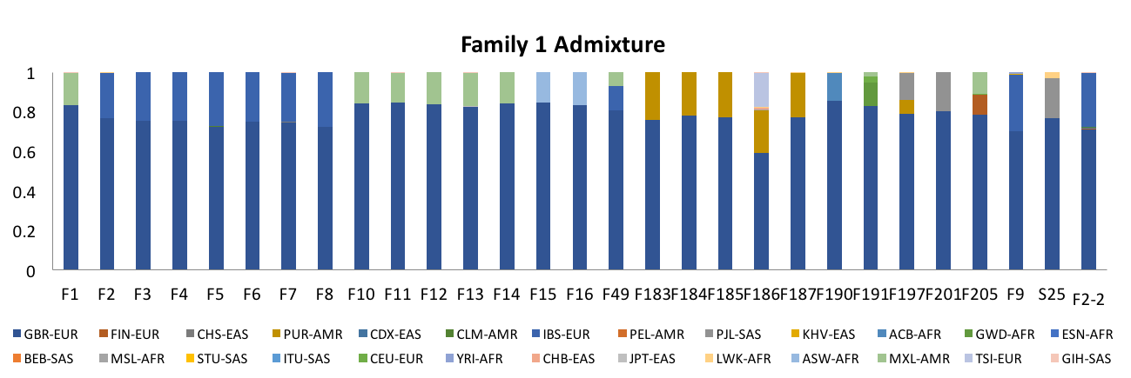
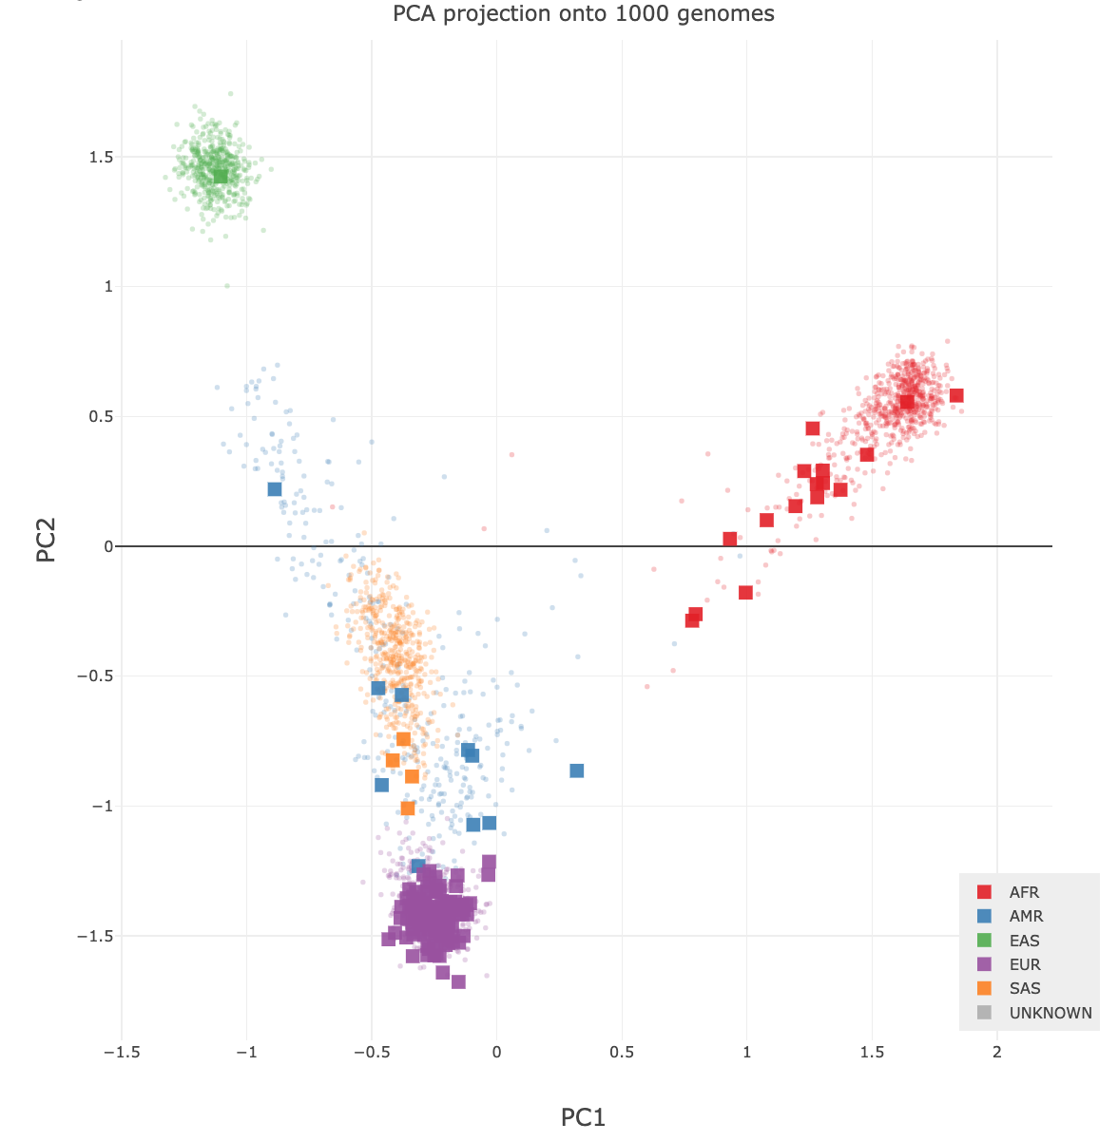
Familial Sequencing Design
3 cases, no controls
  3,176 candidates with global allele frequency threshold of ≤0.01
  2,923 candidates with EUR-only!
PEDDY is a great tool for checking admixture
https://peddy.readthedocs.io/en/latest/
F9
F10*
F1*
F11*
F12*
F13
F14
F49
F3
F4
F2*
F2-2
F15
F205
S25
F183*
F184
F185
F187
F16*
F190
F191
F5*
F6*
F7*
F8
F186
F197*
F201

Slide 44
Germline Variant Calling – Best Practices
Whole genome strongly preferred
  >=30X mean target depth
  Far superior to exome for structural variants, copy number analysis, and SNP/INDEL detection
Germline exome
  >=50X mean depth
For familial/trio analyses, we strongly encourage early consultation
  Selection of samples for sequencing can be CRUCIAL to maximizing power
Notes:
Mention that the error rate for WGS is significantly lower than for exome (even if you only want to analyze exome), and cost is comparable.

Slide 45
Other Considerations and Best Practices for Variant Analysis

Slide 46
Other Considerations and Best Practices for Variant Analysis
Visualization and validation is a necessity

Slide 47
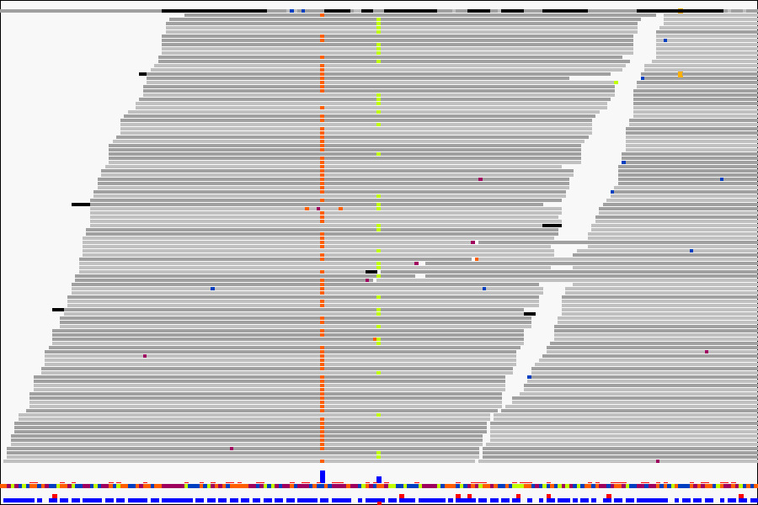
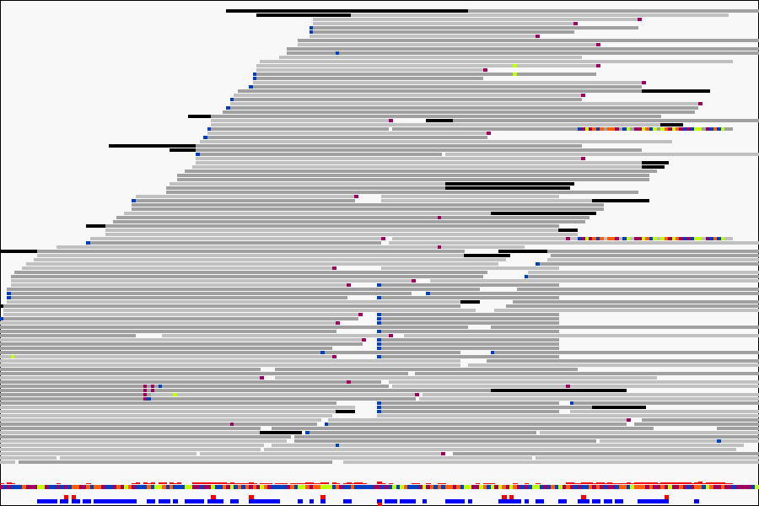
Always Visualize Significant Variants
ABSOLUTELY CRUCIAL!!
ALVIEW (https://github.com/NCIP/alview)
  Internally-developed tool for BAM/SAM visualization (Richard Finney)
True Positive
False Positive
Notes:
Also, SnpEff annotated VCF, and Oncotator somatic annotations followed by MutSigCV mutation analysis for somatic variants

Slide 48
Other Considerations and Best Practices for Variant Analysis
Visualization and validation is a necessity
STRONGLY recommend WGS for any cell line or model organism to be used in quantitative analysis
  Considerable variation exists among cell line replicates in gene and protein expression, and a major contributor to this is genetic heterogeneity
  Model organisms can retain considerable levels of heterozygosity, even after long-term maintenance in colony
  Back-crossing is a necessity
  Drift causes cell lines and model organisms to randomly accumulate genetic differences from progenitors

Slide 49
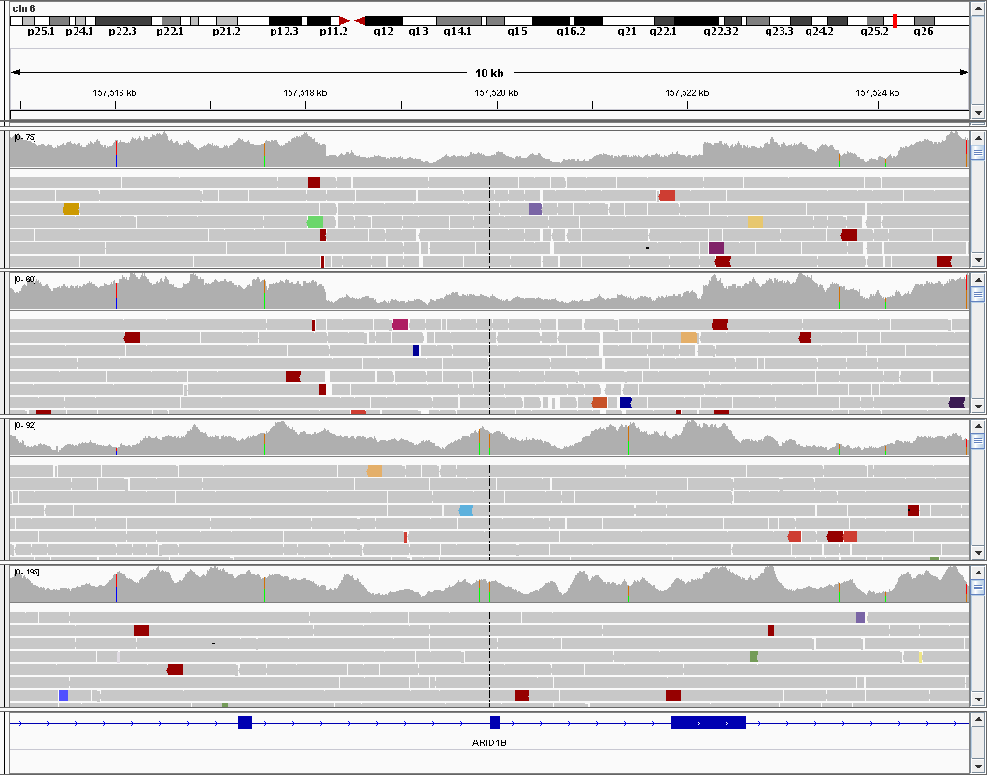
Variant Analysis in Cell Lines
Can never assume your cell lines are homogenous!
This cell line had a subclone with an ARID1B loss
Another subclone had lost the Y chromosome
Replicates of a single-cell established line
Replicates of the parental cell line

Slide 50
Variant Analysis in Animal Models
Mice have retained significant levels of heterozygosity
Vary considerably in regional gene expression

Slide 51
All germline
variants
Hypervariable
regions excluded
Hypervariable regions
only
Chr11 hypervariable
regions only
Chr6 hypervariable
regions only
Chr8 hypervariable
regions only
Notes:
Figure out how much of each chromosome goes to each parental genome (%; PCA ancestry analysis)

Slide 52
Multi-omic Integration
Gene and protein expression data can be used to prioritize variants and genes
  Especially critical in underpowered, small cohort analyses
Germline or somatic variants that do not have expression consequences at the gene and/or pathway level can be reduced in priority
Powerful method for prioritizing non-coding mutations in WGS

Slide 53
Familial Eosinophilia
Maps to 90 Mb window on chromosome 5
WGS and RNAseq was generated approximately 18 months ago
WGS
  5 affecteds, 1 unaffected
RNAseq
  5 affecteds, 5 unaffecteds
  PBMCs
    Not ideal tissue source
    Neutrophil progenitors in marrow

Slide 54
Haplotype Caller SNPS/INDELs
Variant Filtering
8,464,822
Pedigree-based
filtering
45,829
Filtering on WGS data using following criteria:
Autosomal Dominant Model
Rare variant based on ethnicity-aware filtering
  <0.001 ExAC_NFE (non-TCGA)
  <0.01 1kGenomes_Eur
Occurs in linkage window
Regulatory evidence
Remove common vars.
<0.001 ExAC_NFE
<0.01 1kG_Eur
6,935
Chr5:90,000,000-175,000,000
573
Regulatory evidence
Transcription Factor Binding
Overlapping regulatory feature
23

Slide 55
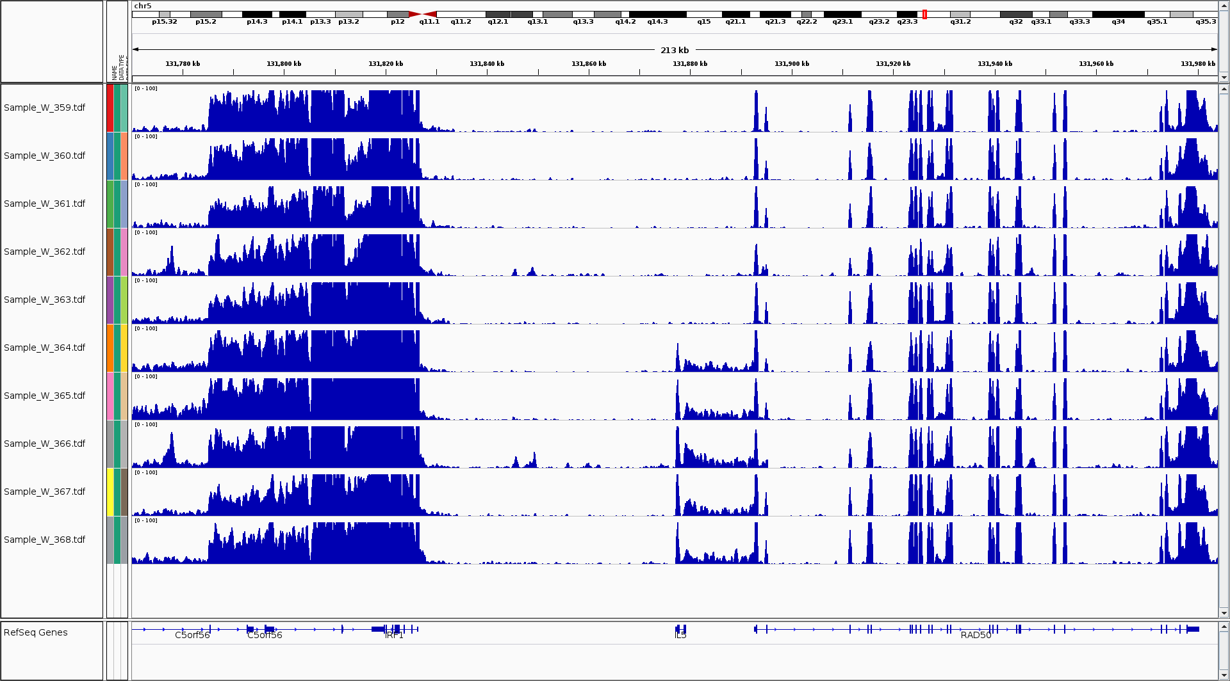

Slide 56
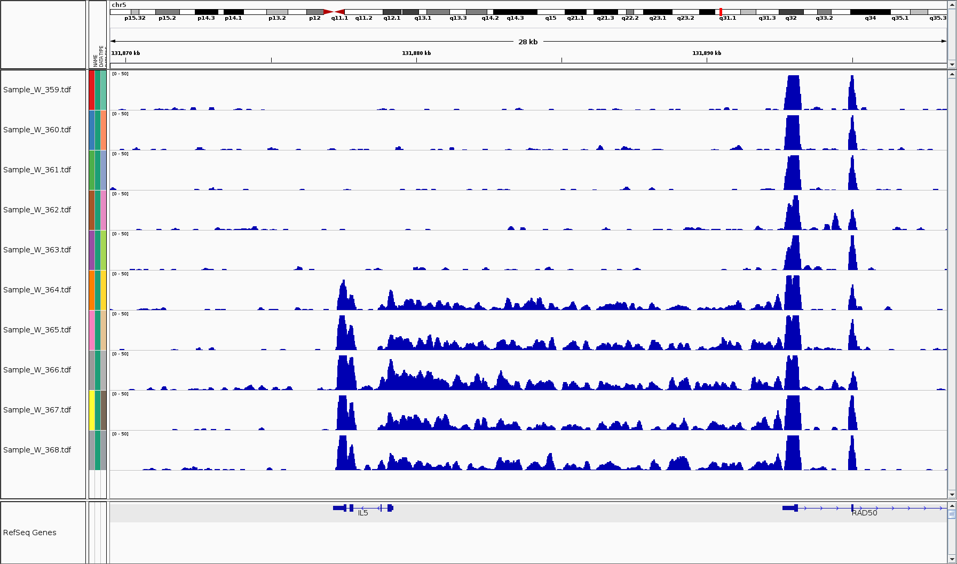

Slide 57
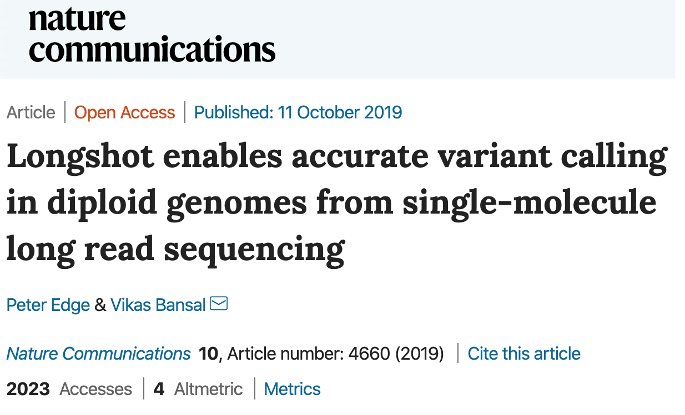
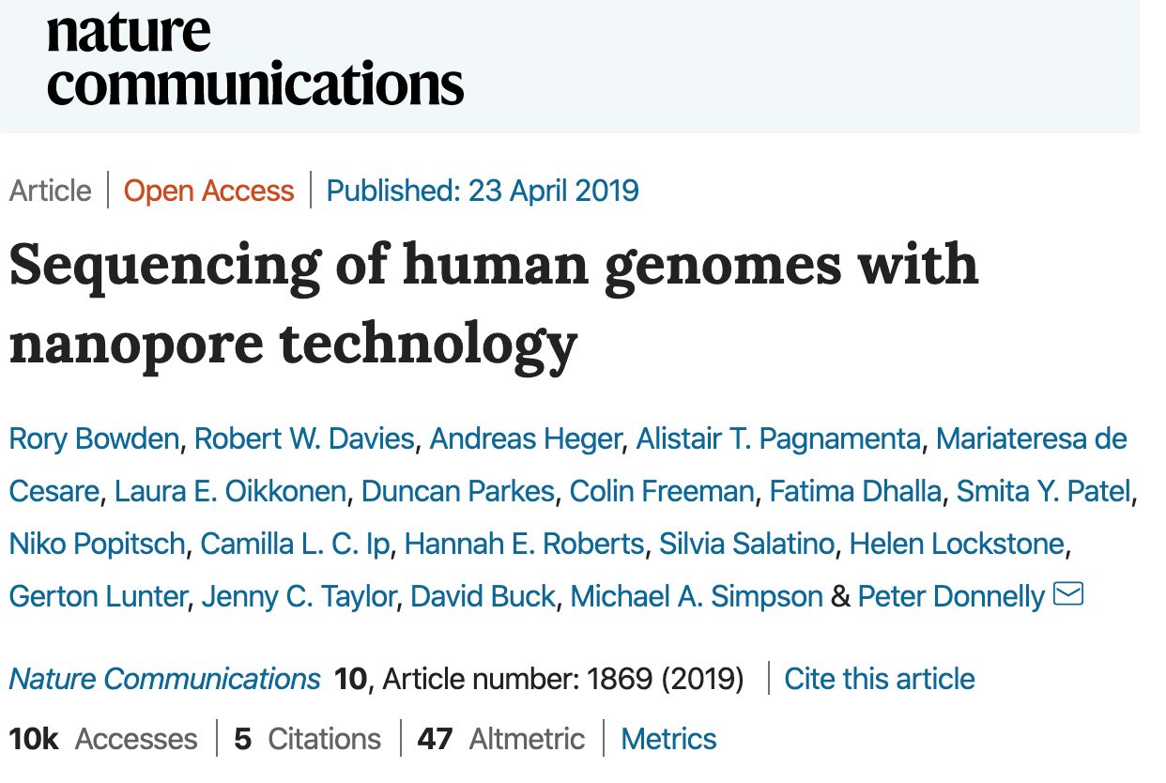
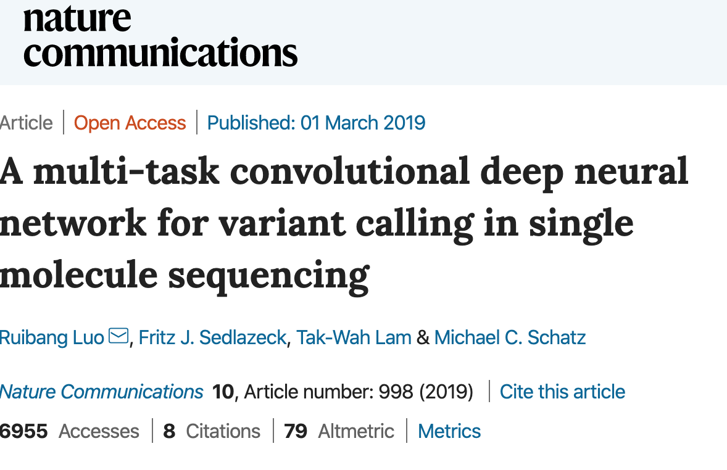
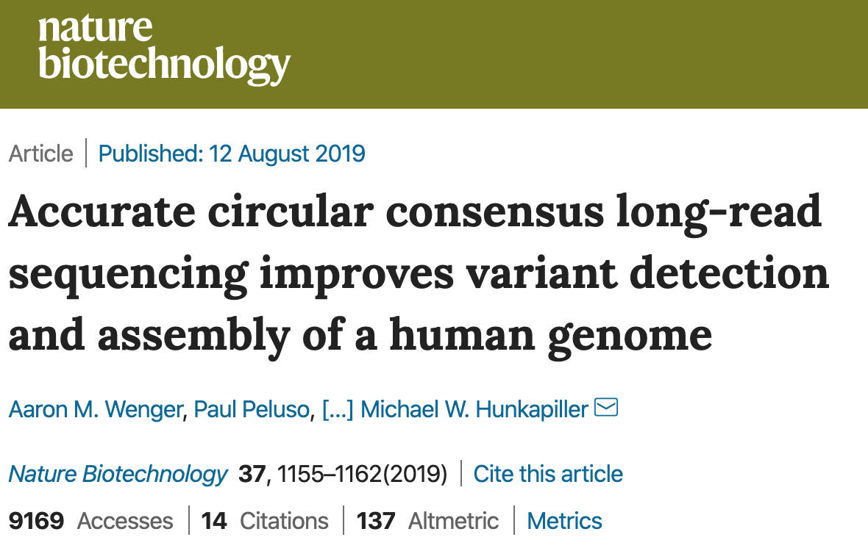
Long-read technologies (PacBio and Nanopore)
High error rate, approaching 10%
Can call and phase all variant types (SNPs, INDELs, SVs/CNVs) from one data set

Slide 58
PacBio Variant Calling
(SNPs/INDELs/SVs)
Raw Reads
raw read qc
CCS reads
fastqc
nanoplot
map to ref
Provide path to fasta and gff3 for annotation to any reference genome, or simply supply ensemble annotation ID (e.g., GRCh38.p13)
ccs read qc
minimap2 (pbmm2)
fastqc
nanoplot
de novo
assembly
GATK4
HaplotypeCaller
PacBio-specific parameters:
--pcr-indel-model AGGRESSIVE
--minimum-mapping-quality 60
AS_StandardAnnotation
SNP/INDEL
calling
bam qc
PBSV
picard
qualimap
samtools
HGAP4
Canu
Flye
MECAM
GATK4
VariantsToTable
BCFtools
VEP
Hard-filter variants:
SNPs and >1-base INDELS AS_QD < 2.0
1-base INDELs AS_QD < 5.0
Quast
assembly evaluation
Annotated SV Table
GATK4
VariantsToTable
Comprehensive MultiQC
Report
BCFtools
VEP
Annotated SNP/INDEL Table

Slide 59
CCBR Pipeliner

Slide 60
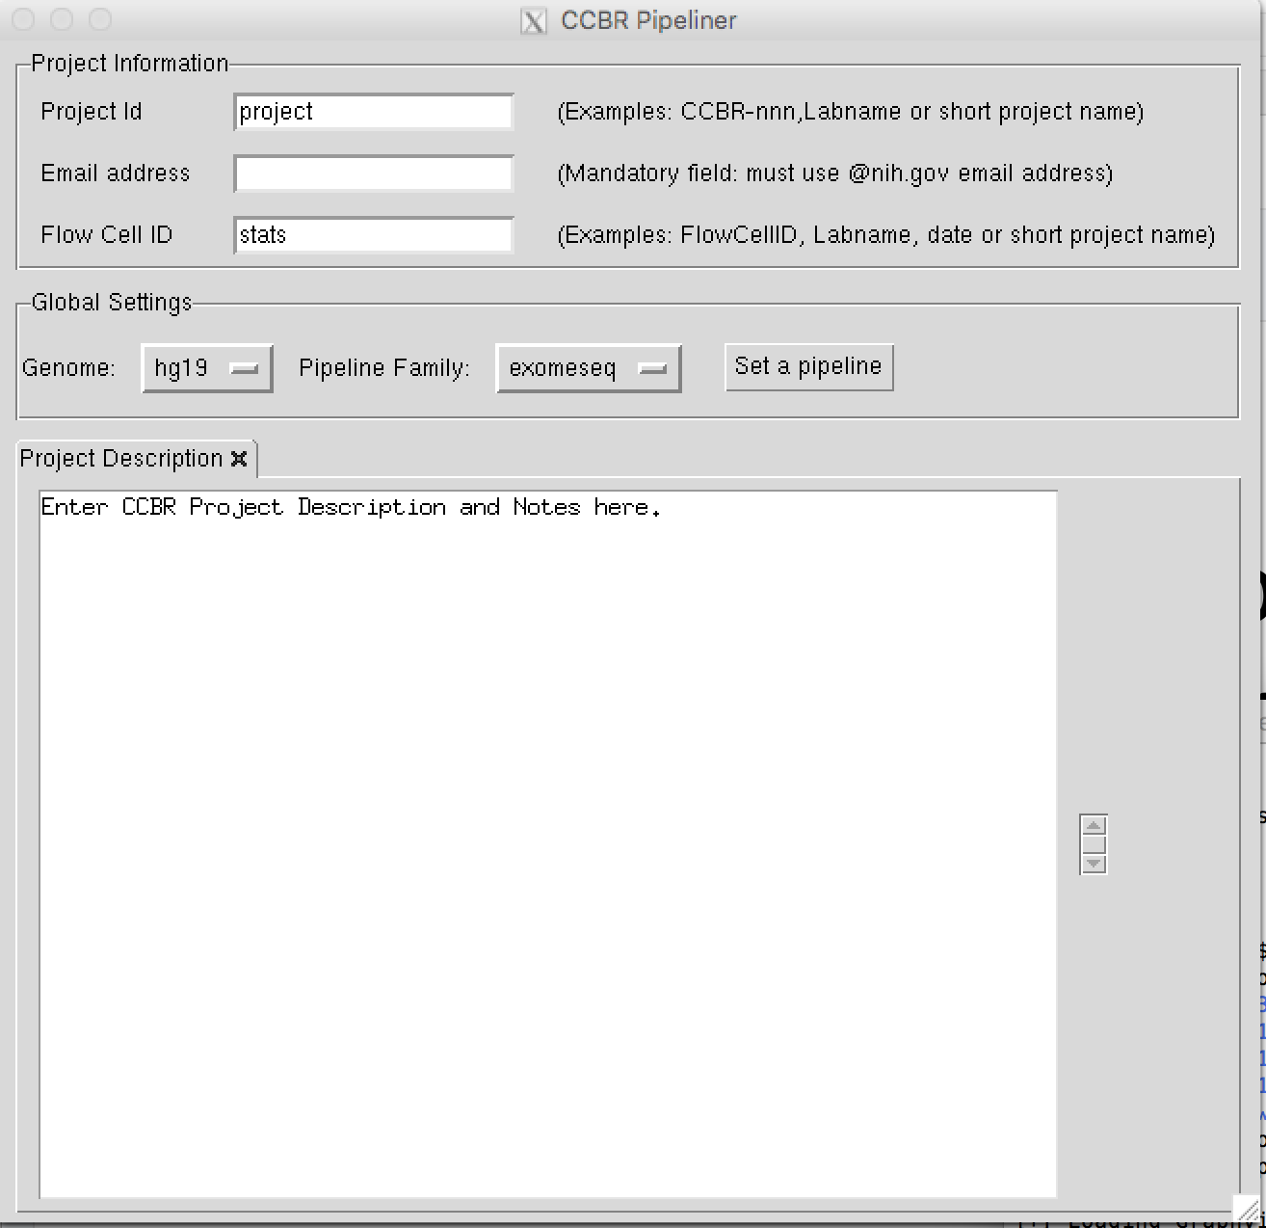
Variant Calling at CCBR
Multiple Variant Calling CCBR Pipelines
  Whole genome (germline and somatic)
  Whole exome/targeted sequencing (germline and somatic)
  Variants from RNAseq
All variant calling pipelines available through CCBR_Pipeliner app
  https://github.com/CCBR/Pipeliner
  Just need Biowulf account and xquartz installed on our local machine
  module load ccbrpipeliner (enter)
  ccbrpipe.sh (enter)

Slide 61
WES/WGS Variant
Workflow(s)
FREEC
Sequenza

Slide 62
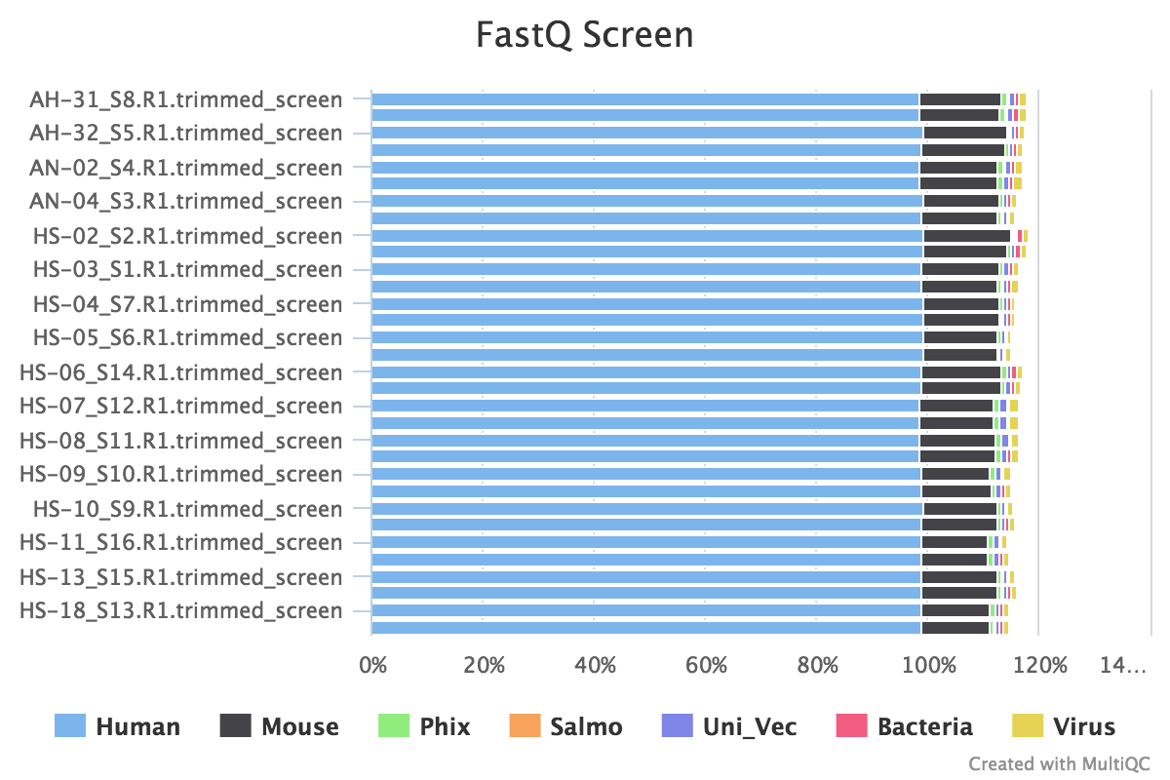
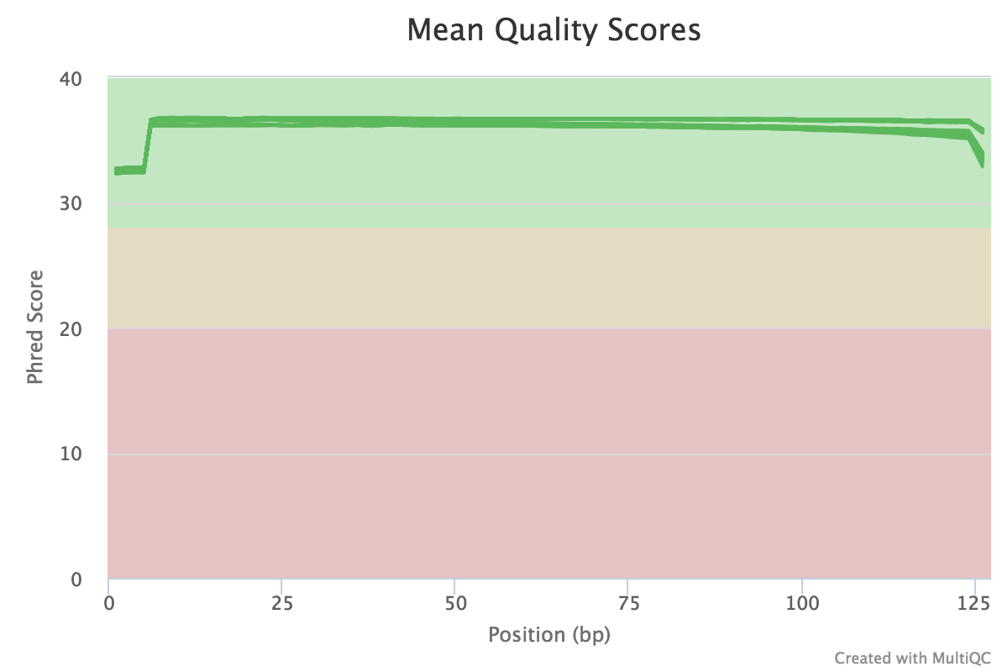
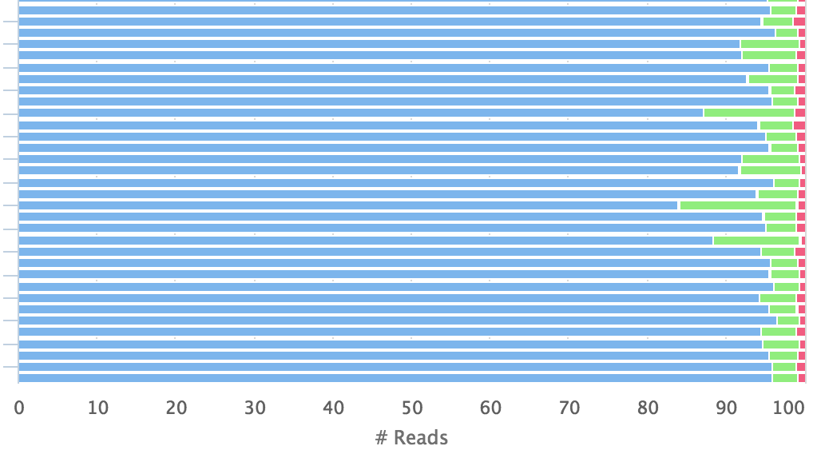
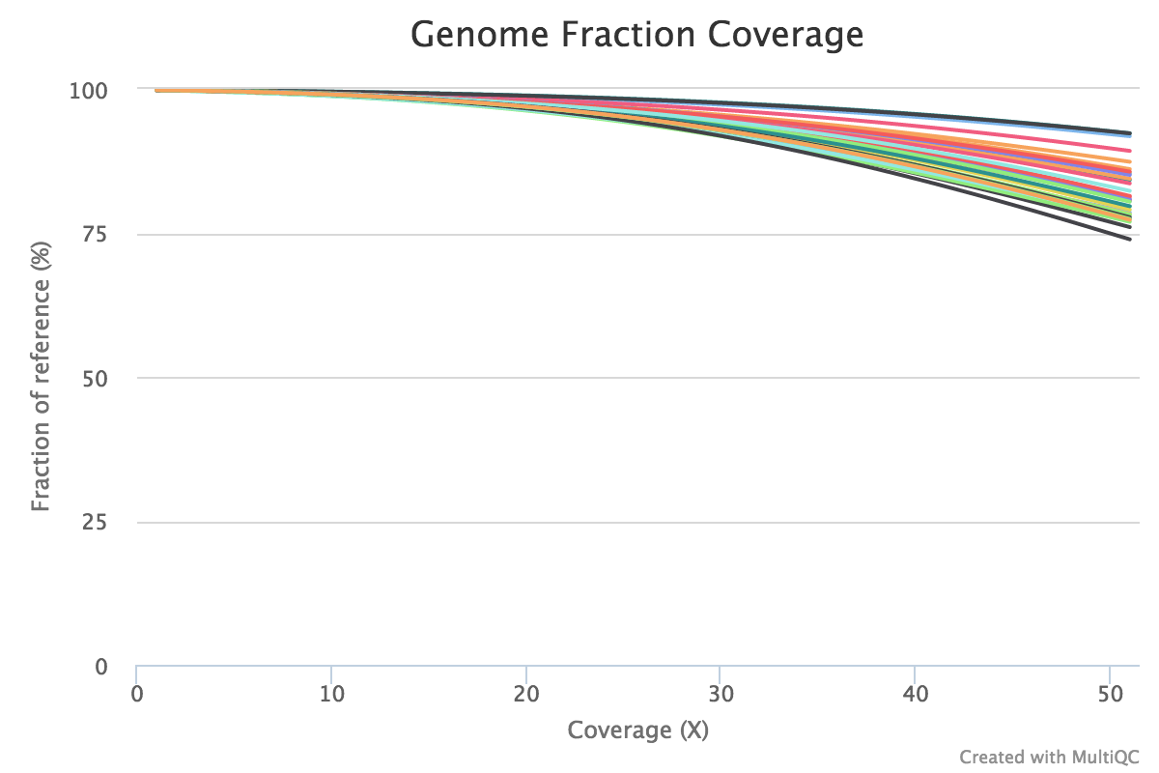
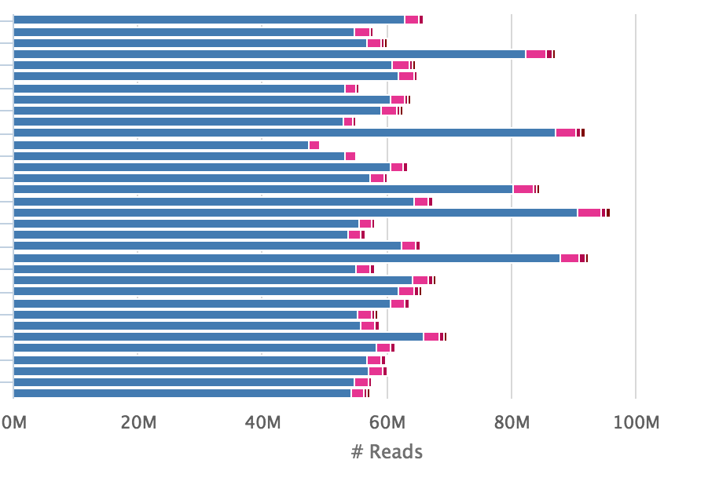
RNAseq Variant Calling
http://gatkforums.broadinstitute.org/gatk/discussion/3892/the-gatk-best-practices-for-variant-calling-on-rnaseq-in-full-detail
Contamination Summary
Alignment/Read QC
Variant
Annotations
Read Quality
AVIA
+
SnpEff
Duplication Stats
CoverageStats
Read Trimming
Summary

Slide 63
Pipeline Details…
Read Processing/QC
All variant calling follows the same basic approach
Read Mapping
BAM Processing/QC
Variant Calling
Variant Annotation

Slide 64

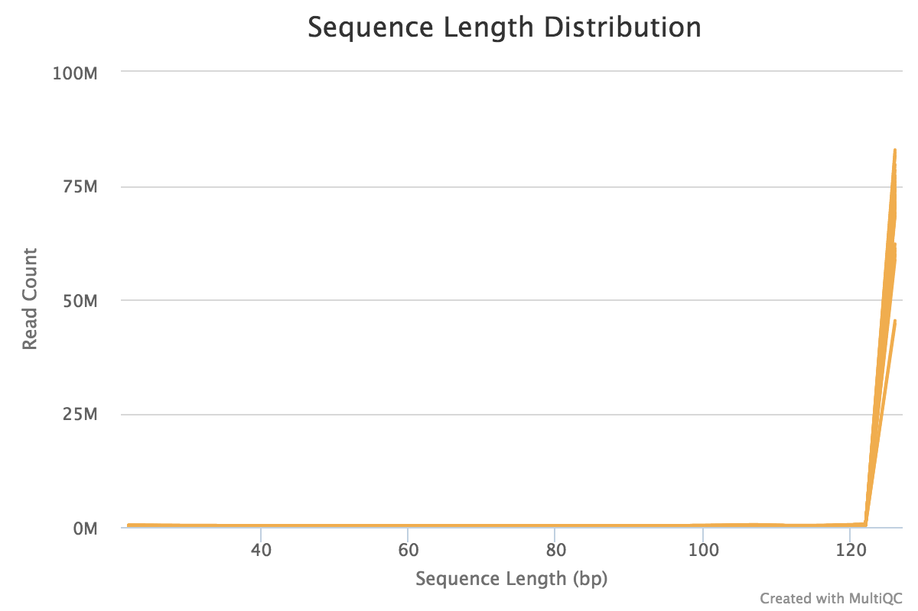
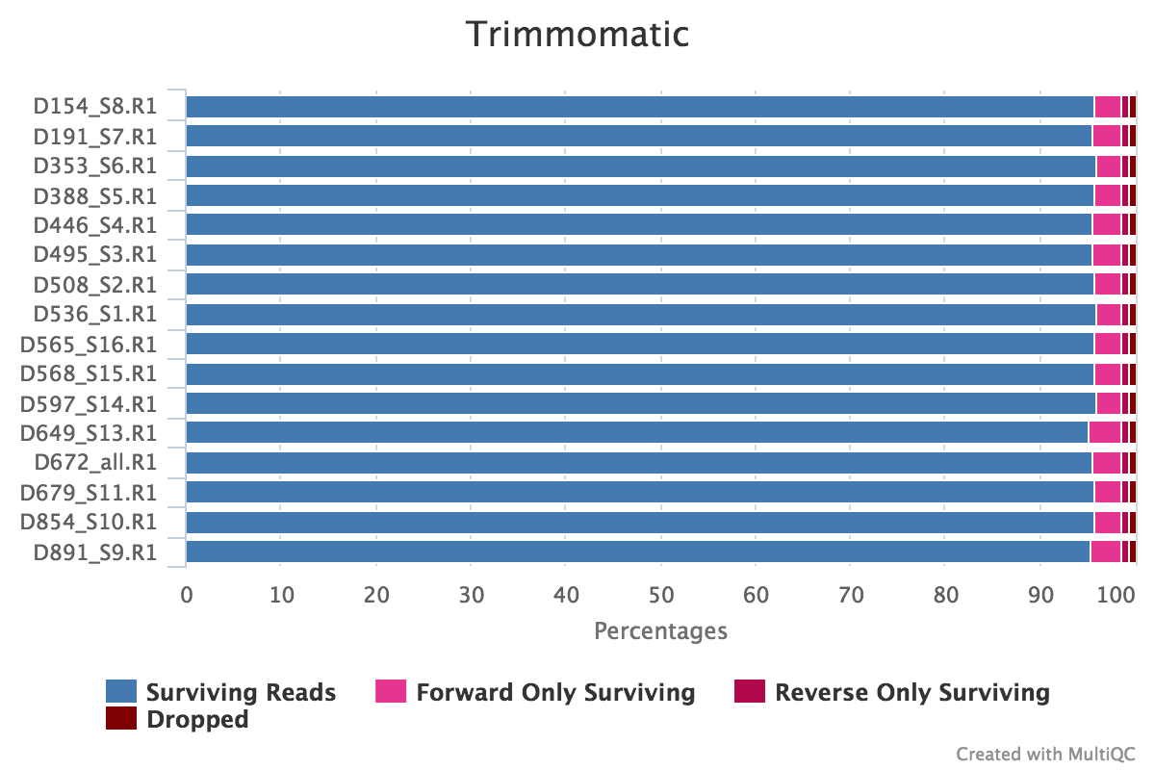
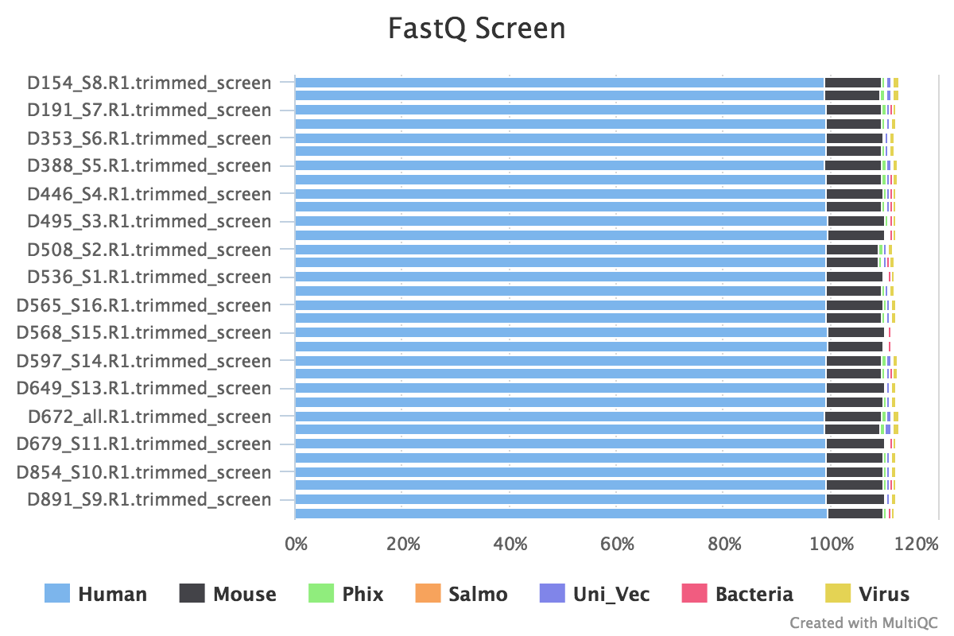
Pipeline Details…
FastQC to assess Read Qual.
Base Qual.
GC%
Length Dist.
Trimming
Read Length
Contamination
Read Processing/QC
Read Mapping
BAM Processing/QC
Variant Calling
Variant Annotation
Notes:
adapter and quality trimming/assessment, contamination quantification

Slide 65
Pipeline Details…
Read Processing/QC
FastQC to assess Read Quality
  Base quality
  GC%
  Length distribution
Trimming with Trimmomatic or Cutadapt
Fastq Screen and Kraken for contamination screening
Notes:
adapter and quality trimming/assessment, contamination quantification

Slide 66
Pipeline Details…
Read Processing/QC
Read Mapping
BAM Processing/QC
Variant Calling
Variant Annotation
Notes:
Exome and genome mapping with BWA-mem, RNAseq with STAR 2-pass. All reference mapping

Slide 67
Pipeline Details…
Read Mapping
BWA-mem for WES and WGS pipelines (DNA-based)
STAR for all RNAseq variant calling (splice-aware mapping)
Notes:
Exome and genome mapping with BWA-mem, RNAseq with STAR 2-pass. All reference mapping

Slide 68
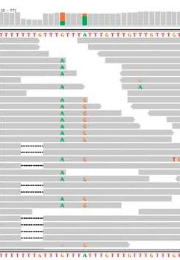
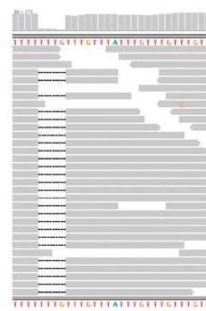
Pipeline Details…
BAM Processing/QC
Indel realignment
GATK IndelRealigner
STAR for all RNAseq variant calling (splice-aware mapping)
Local realignment
Notes:
Ensure consistent alignment of indels across samples, and removes

Slide 69
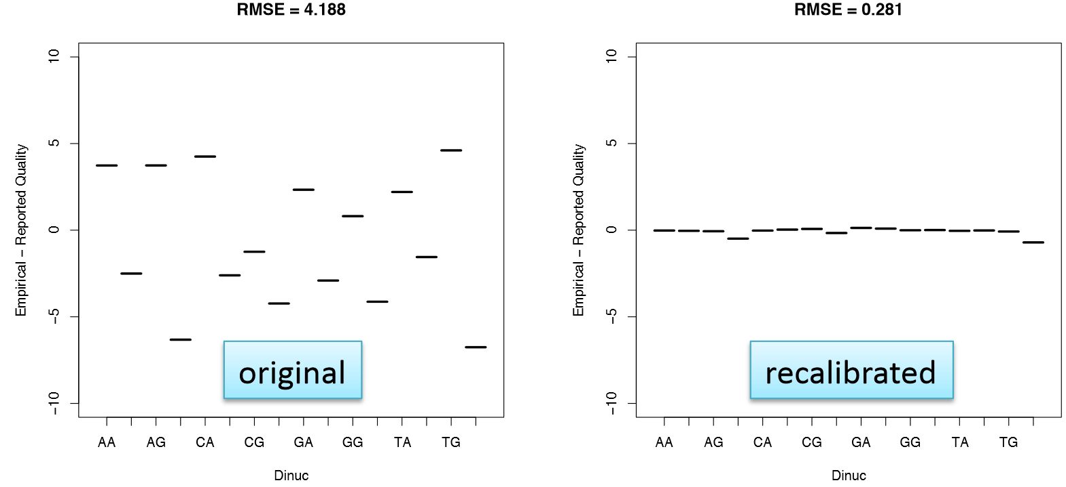
Pipeline Details…
BAM Processing/QC
Multiple sources of quality score bias
GATK IndelRealigner
GATK BaseRecalibrator
Notes:
Removes sequence context biases (i.e., AA qualities are higher than GG qualities, biasing towards GG -> AG mutations, but away form the opposite condition)

Slide 70
Pipeline Details…
BAM Processing/QC
Extra step for RNAseq BAM processing:
GATK IndelRealigner
GATK BaseRecalibrator
GATK SplitNCigarReads
Notes:
Removes sequence context biases (i.e., AA qualities are higher than GG qualities, biasing towards GG -> AG mutations, but away form the opposite condition)

Slide 71
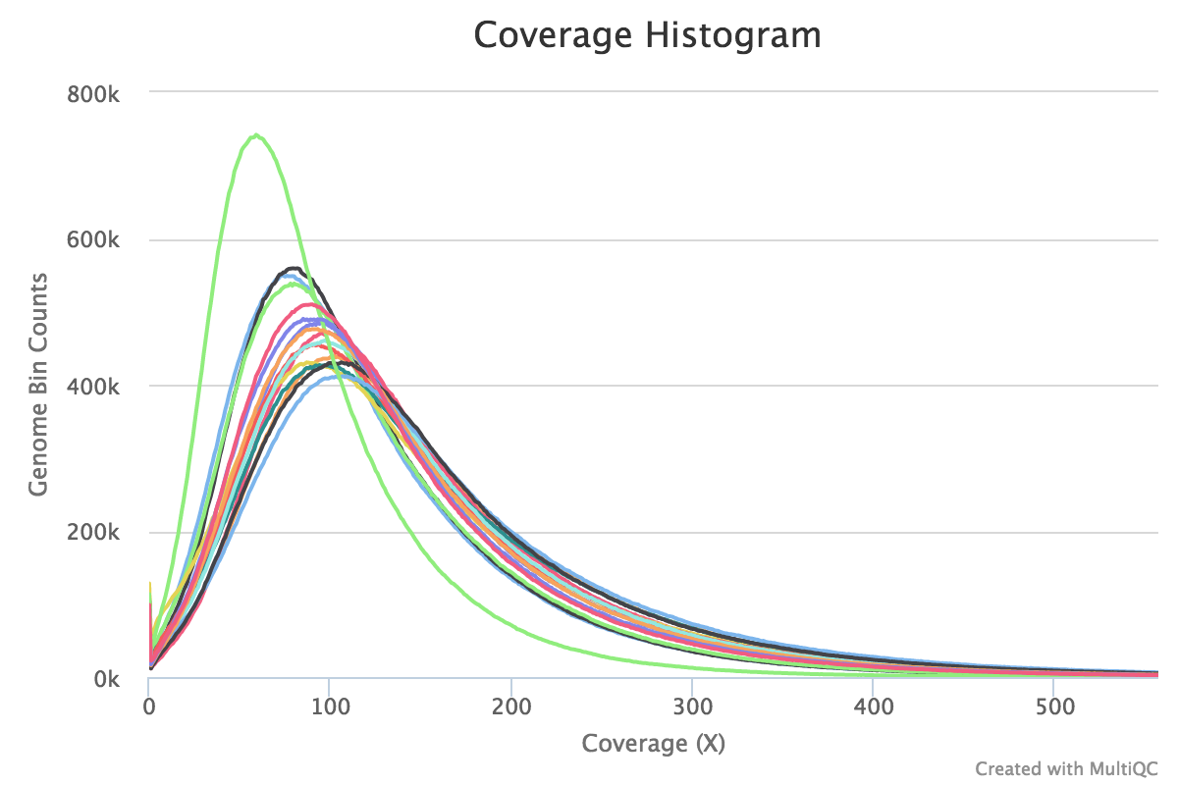

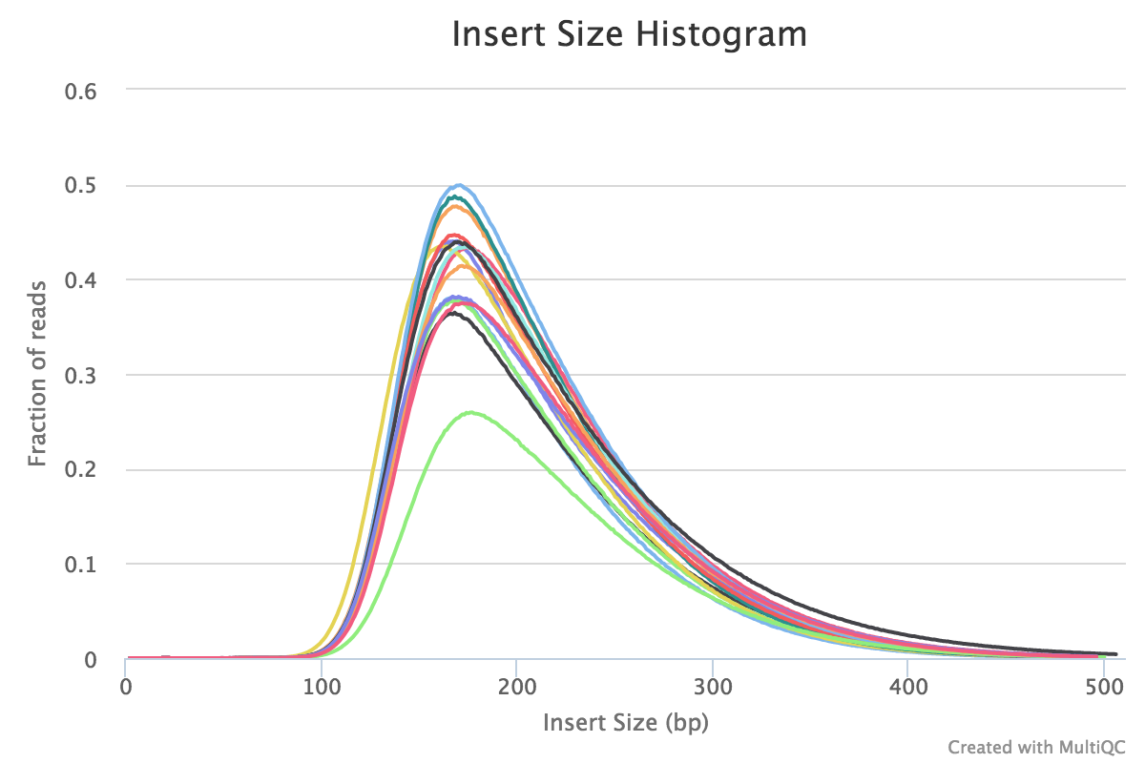
Pipeline Details…
BAM Processing/QC
Alignment QC
Qualimap, Bamtools, and Samtools:stats to assess coverage and mapping statistics
Notes:
Assess coverage, depth, and paired-mapping

Slide 72
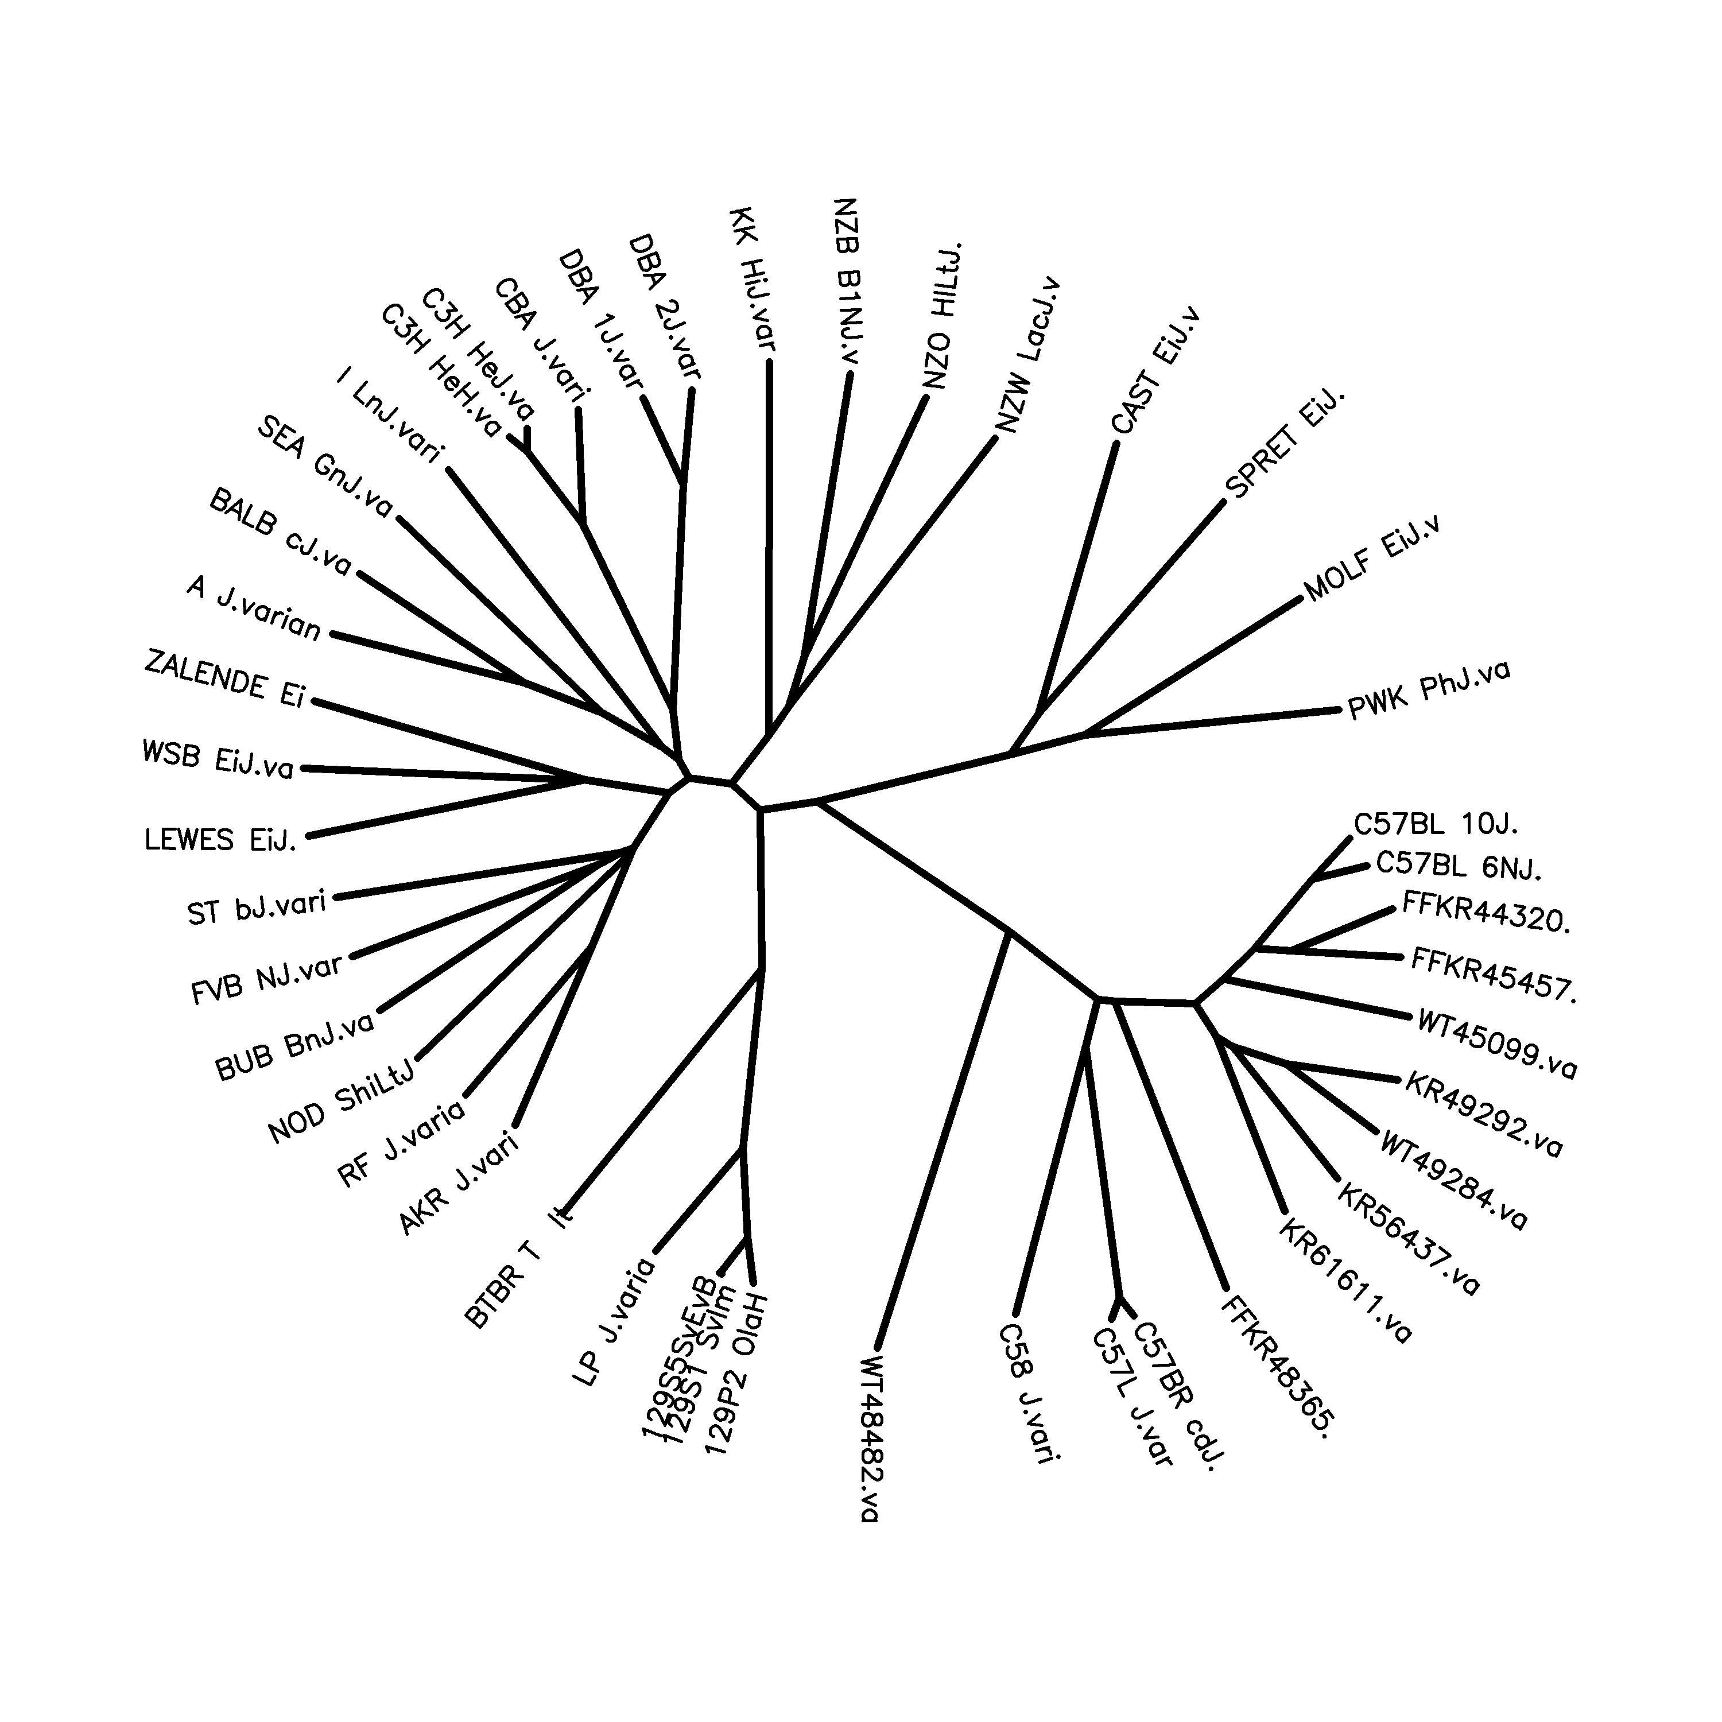
Variant Calling at CCBR
Read Processing/QC
Additional QC
Read Mapping
BAM Processing/QC
Variant Calling
Variant Annotation
Notes:
Assess coverage, depth, and paired-mapping

Slide 73
Variant Calling at CCBR
Read Processing/QC
Read Mapping
Germline
  Joint genotype with GATK HaplotypeCaller
    SNPs/short INDELs
  We have benchmarked and optimized a series of hard filters for removing errors
BAM Processing/QC
Variant Calling
Variant Annotation
Notes:
In addition, call large structural variants including large insertions/deletions, translocations, inversions, and duplications/copy#

Slide 74
Variant Caller Performance and Filtering
99.41
RelaxedFilter
StrictFilter
99.61
99.565
99.67
99.69
99.6

Slide 75
GATK - Variant Quality Score Recalibration (VQSR)
Rate (Errors/Variant)

Slide 76
Variant Calling at CCBR
Read Processing/QC
Somatic
  MuTect, MuTect2 (with hard filters), Strelka
Read Mapping
BAM Processing/QC
Variant Calling
Variant Annotation
Notes:
Point out differences between Tumor/Normal calling, and Tumor only calling (basically, start after first phase). Also, LOD score at left is log10 of prob/likelihood it’s real over prob/likelihood it’s not, then some hard filters, PON subtraction, annotation

Slide 77
WES/WGS Pipelines with Multiple Entrypoints
Can be run starting from fastq reads, BAMs, or gVCFs
Setup within raw data directory
  Raw reads all in main directory
  ‘bams’ directory containing all BAM files from any source (e.g., Dragen)
  ‘gvcfs’ directory containing all gVCFs from any source (e.g., Dragen)
Initialize as usual
  During initialization, Pipeliner automatically symlinks BAMs and gVCFs if there is a ‘bams’ and/or ‘gvcfs’ directory
Run as usual, but skip initialQC and start from the variant calling pipeline that is appropriate

Slide 78
How do our Pipelines perform?

Slide 79
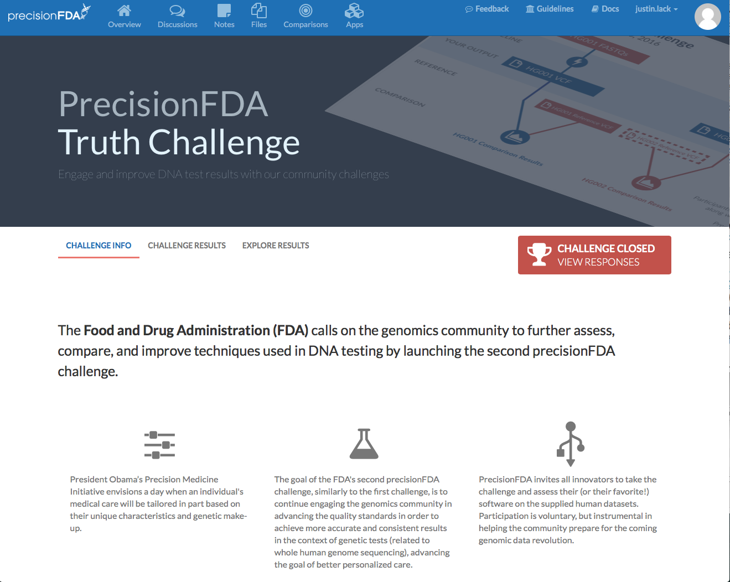
FDA Consistency/Truth Challenges
Sought to establish best practices for germline variant calling

Slide 80
FDA Consistency/Truth Challenges
GIAB genome (NA12878) provides known real data truth set
Second genome (NA24385) provides unknown truth set
  Eliminates “overtraining” problem
Challenge(s):
  Pipeline determinism
  Precision/recall on a known truth (training set available)
  Precision/recall on unknown truth

Slide 81
FDA Consistency/Truth Challenges
Performance of most recent pipeline version
CCBR
Recall: 99.925
Precision: 99.957
F-Score: 99.942
Proportion/Score

Slide 82
FDA Consistency/Truth Challenges
Performance of most recent pipeline version
99.9495
98.6993
Score
Score

Slide 83
Pipeline performance vs Sentieon and Dragen - Recall vs Precision (with Keyur Talsania, CCR Sequencing Facility)

Slide 84
FDA Hidden Treasure Challenge
NA12878MOD generated by in silico modification of NA12878
50 Spike-in variants >=0.2 frequency
INDELs <= 40bp
Evaluate ability to detect in silico variants
FP/FN balance for SNPs and INDELs
Ability to accurately call allele frequencies

Slide 85
FDA Hidden Treasure Challenge
86 entries
Ran the full somatic pipeline with both strict and relaxed filtering criteria

Slide 86
FDA Hidden Treasure Challenge
86 entries
Ran the full somatic pipeline with both strict and relaxed filtering criteria
Successfully recovered all 50 spike-in variants

Slide 87
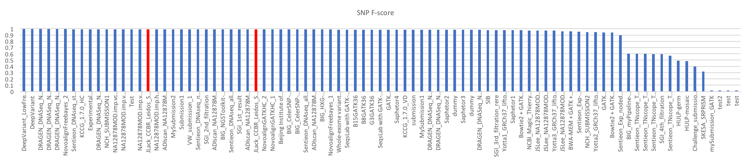
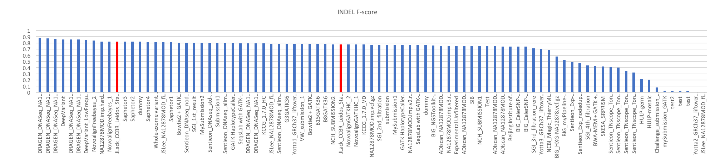
Performance - F-score

Slide 88
A Pipeliner Demo…

Slide 89
Questions?

